Slide 1
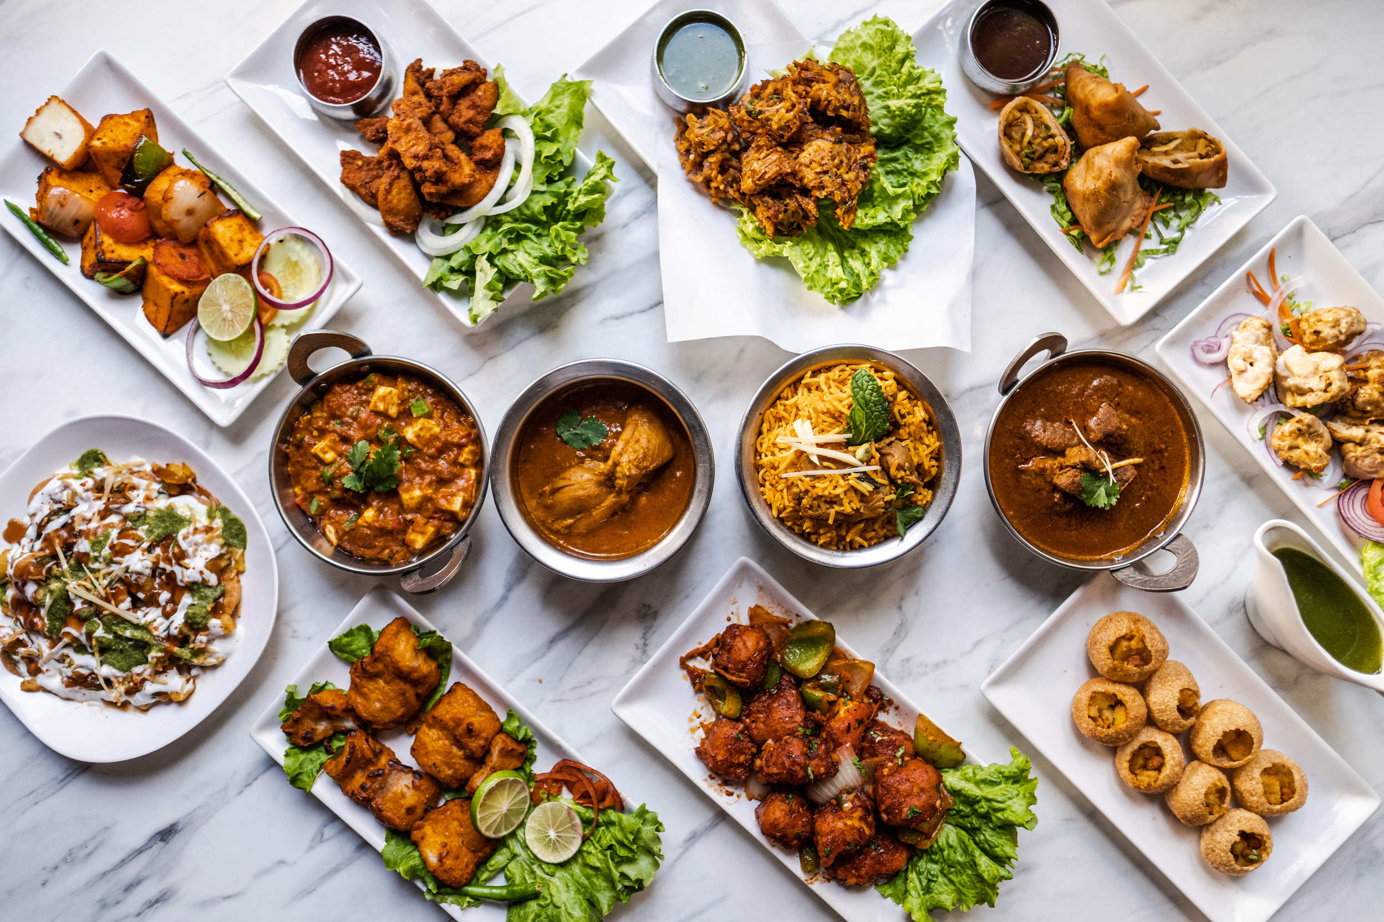


Slide 2
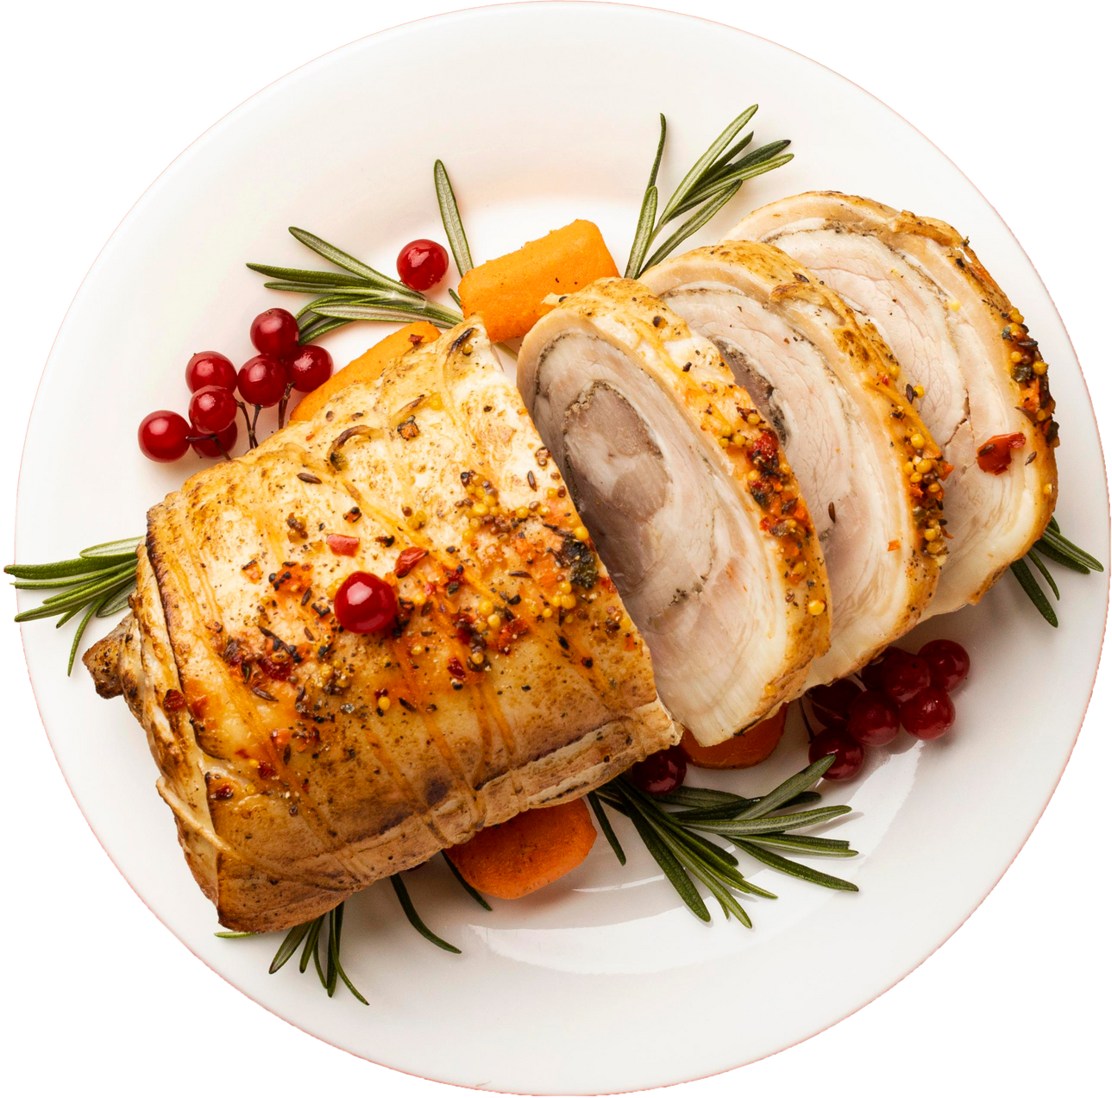
Objective
"There are many applications that provide the solution to purchase the food online 24 X 7 in India. Therefore it becomes hectic task to compare the prices, to order the food and get the best within our price range and good reviews. Here comes Aahaar, that provides the solution to compare the prices of particular outlets among various platforms."

Slide 3

Novelty of the Aahaar
Helps the user to find the best deal among the food tech websites.
Helps the user to get the recommendation of restaurants as per the locality and affordability of the user.
Convenience for the cloud kitchens to provide them wider reach and more users, results into profitable business.

Slide 4
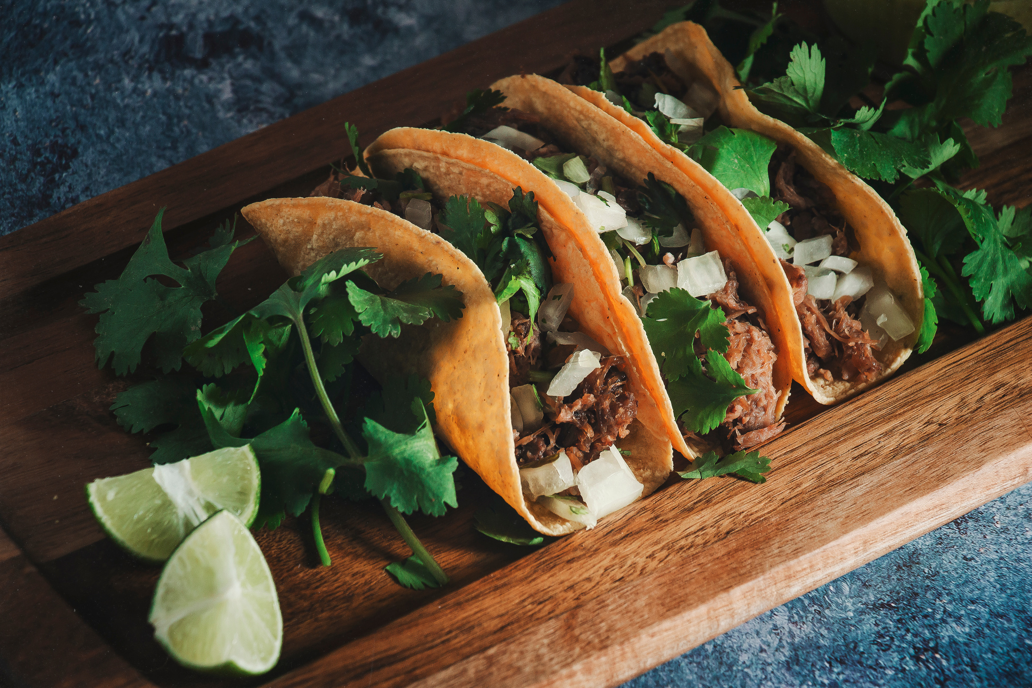
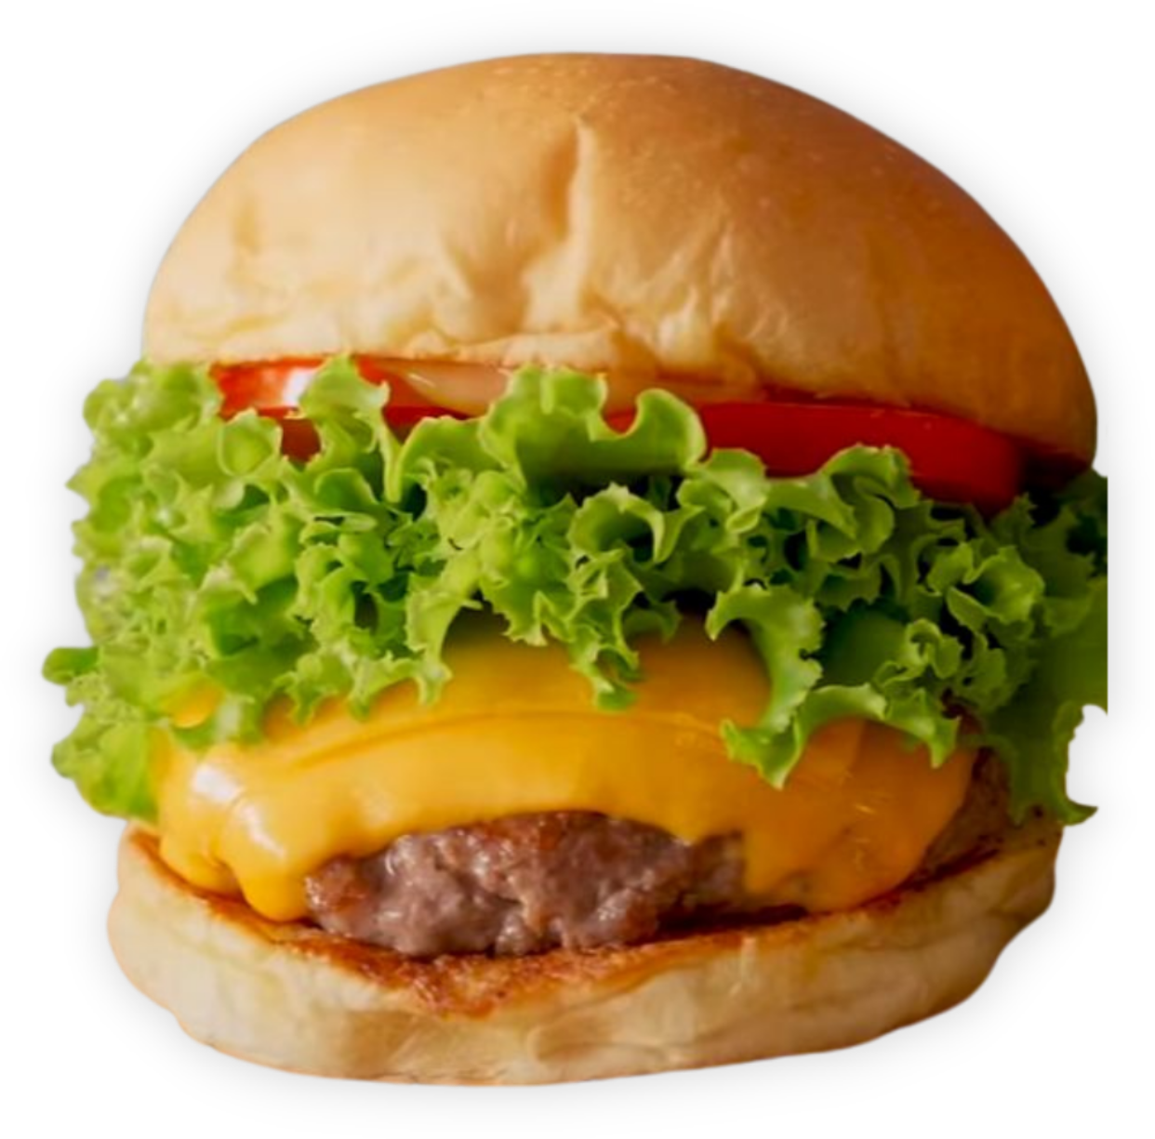
Revenue Model
Minimal charges applied for delivery from cloud kitchen to the consumer.
Business for the local vendors who are not listed on websites like Swiggy, Zomato, even today.
Business as per the reviews and price range to suggest/recommend the options in the particular locality.
Platform for advertisement of local food businesses at affordable prices.

Slide 5





OUR TEAM
Ruchika Yadav
Anmol Pal
Prakhar Dubey
Anuj Bisht

Slide 6
Thanks!

